Slide 1
WGITA Project 2 update Audit of IT management – Governance, Outsourcing, Sustainability
SAI India

Slide 2
Project 2 goals and the team
Audit Guidance doc on IT Management
Provide advanced level guidance to actual conduct of audits covering
IT Governance
IT Outsourcing
IT Sustainability
Enhanced checklists and examples
Enable audit teams to make meaningful recommendations

Slide 3
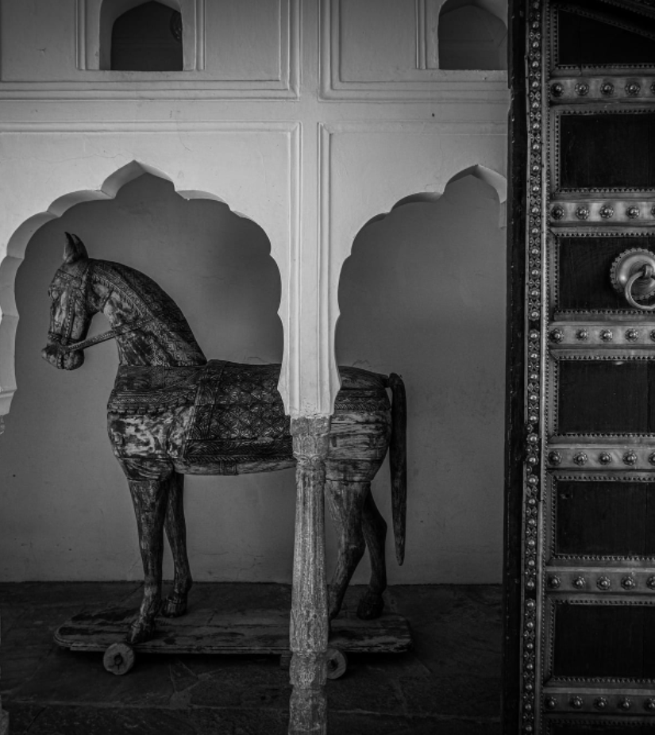
Project Work Update
Practice Guide -
Audit of IT management

Slide 4
Chapters and Sections
Chapter/ Section | Content | Status update
1 | Audit of IT Governance
1A | Risks re: IT governance
1B | Audit matrix on IT Gov
1C | Audit finds n recommendations
Draft mapped to new Handbook and COBIT 2019
IT Gov audit program-
Handbook matrix updated – Team review on
Section drafted. (WGITA, ITWG n SAI)- Team review on
2 | Audit of IT Outsourcing (incl cloud computing)
2A | Risks re: Outsourcing
2B | Audit matrix on IT outsourcing
2C | Audit finds n recommendations
Revised draft done –covers cloud computing and traditional outsourcing. Team review on
Revised draft done. Team review on
Section drafted. Team review on
3 | Audit of IT Sustainability
3A | Sustainability Risks re: IT practices
3B | Audit matrix on IT sustainability | SAI Ecuador, India
 |  | -
First draft done and reviewed
Revised draft in progress

Slide 5
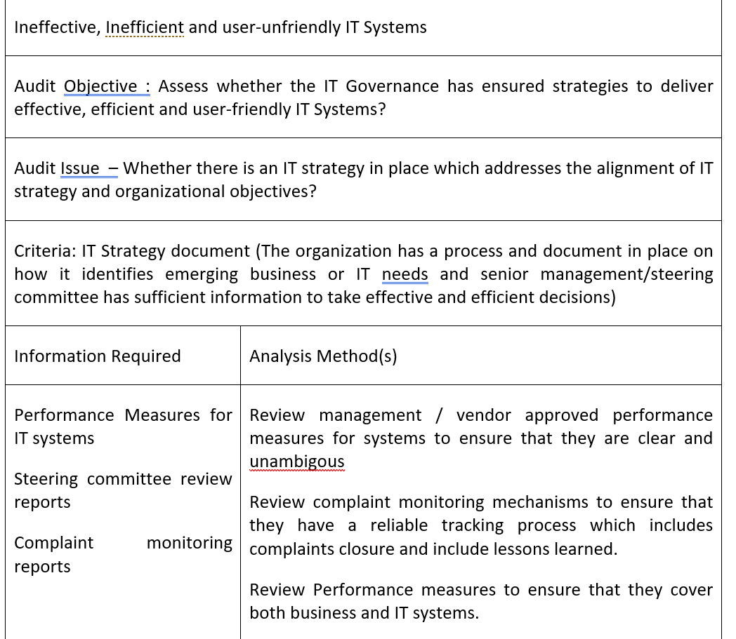
Section B – Audit matrices

Slide 6
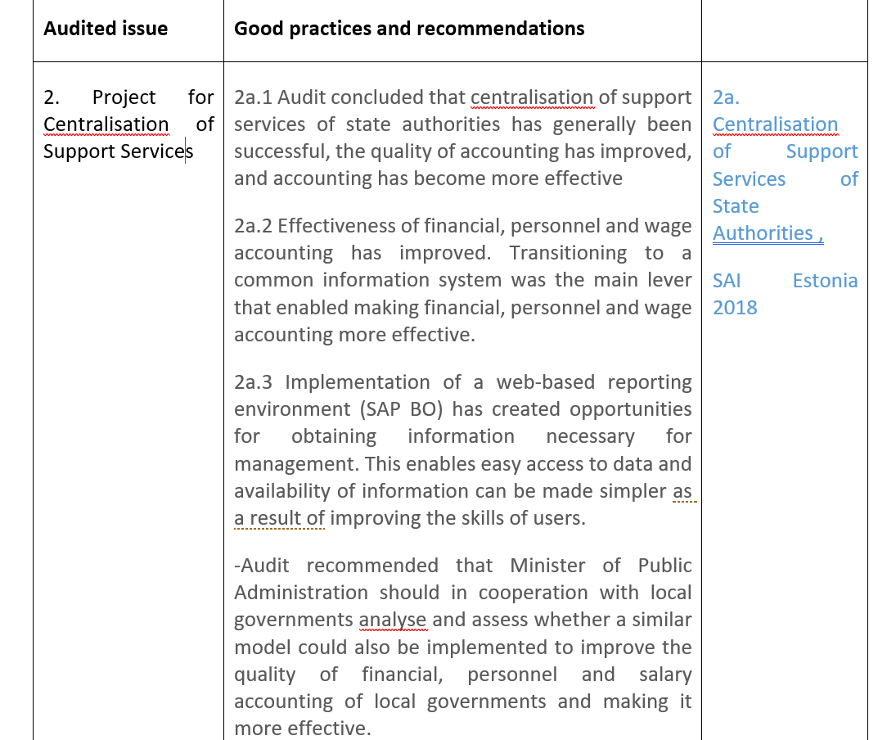
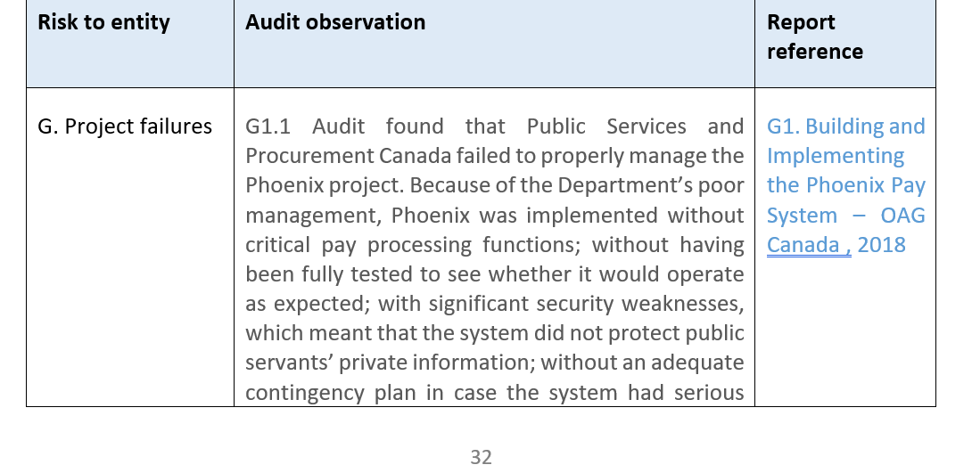
Section C Audit finds, best practices and recommendations

Slide 7
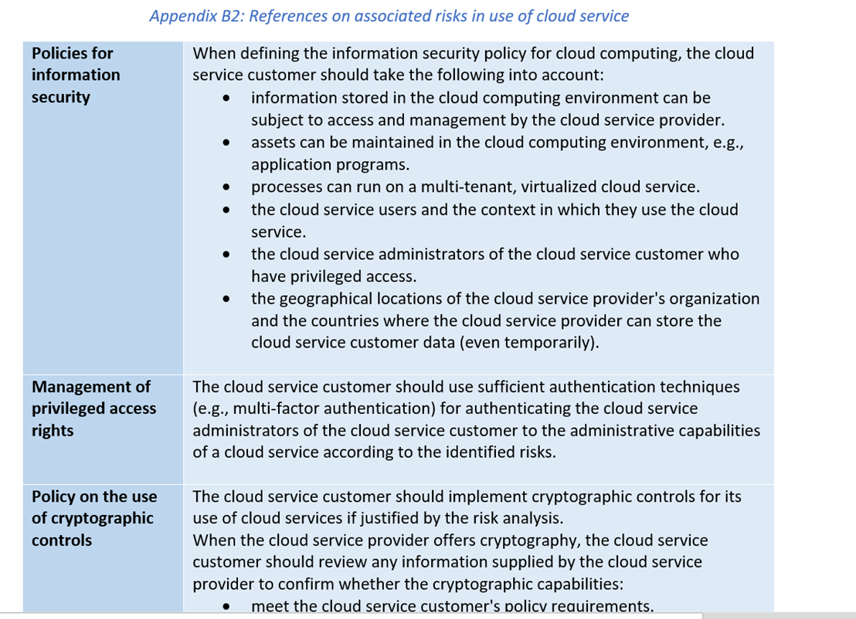
Chapter 2A IT Outsourcing- Cloud computing

Slide 8
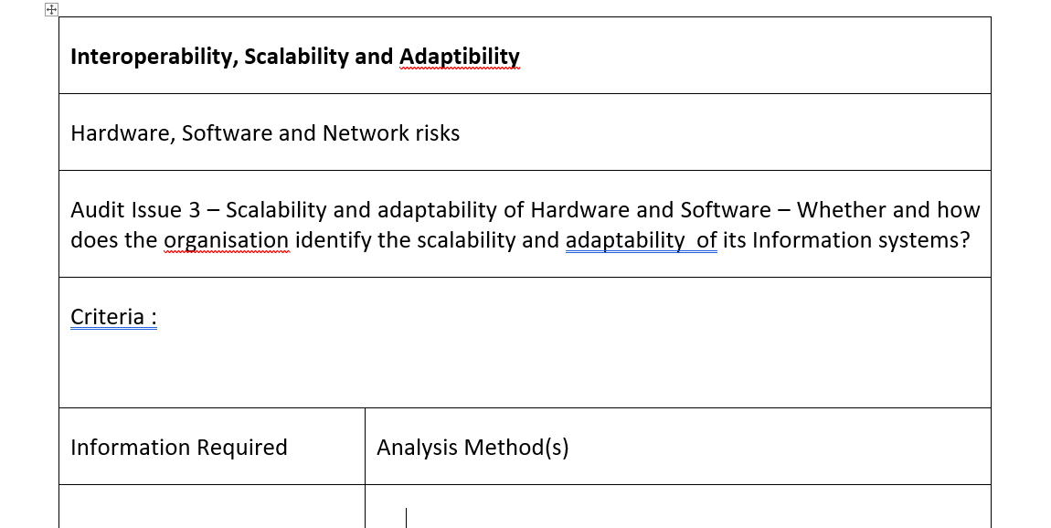
Chapter 3 – Audit of IT Sustainability

Slide 9
Areas to address
Guidance Doc on Audit of IT Management

Slide 10
Project tasks before circulation
Sec 1C - Audit examples and recommendations – sync with new Handbook
Sec 2A – needs harmonisation with Handbook chapter – covers cloud services and audit areas in much deeper detail
Sec 2C – needs sync with examples indicated in the Handbook
Sec 3C – audit examples – responses during circulation of Exposure draft to WGITA members
Resizing of the final exposure draft

Slide 11
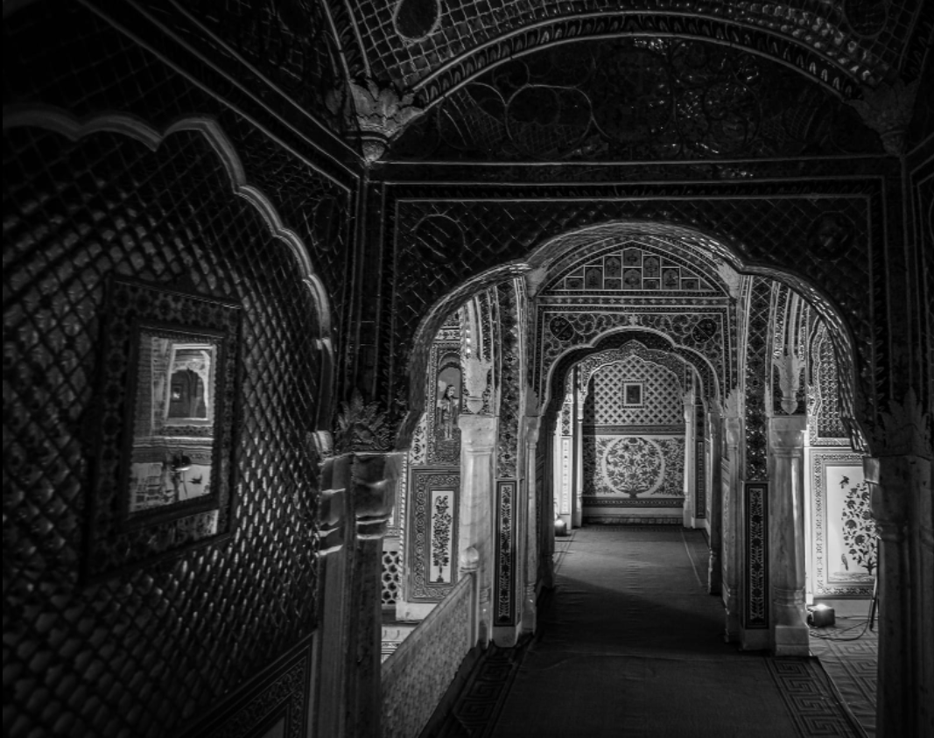
Steps ahead
WGITA project 2-
Guidance doc on Audit of It Management

Slide 12
What next ?
Circulate Exposure Draft to WGITA member SAIs, other forums –Aug 2022
Gather response and make necessary changes –Nov 2022
Final endorsement draft Submission to WGITA chair –Dec 2022
Make the Guidance doc available on WGITA website for enabling related audit engagements.

Slide 13
Thank You
Questions ?
This Photo by Unknown Author is licensed under CC BY-ND

