Slide 1
Government eProcurement Audit
Experience of SAI Indonesia
WGITA Seminar, May 24, 2022

Slide 2
Outline
Public procurement system in Indonesia
SAI Indonesia’s Experiences
E-procurement Risks
Strategies in Auditing E-Procurement System
Data Analytics for Auditing e-procurement

Slide 3
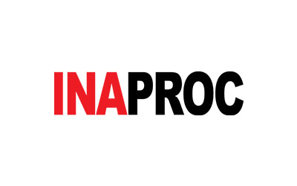
Public procurement system in Indonesia
Public Procurement System is regulated and developed by the National Public Procurement Agency (or Lembaga Kebijakan Pengadaan Barang/Jasa Pemerintah/LKPP).
NPPA is responsible to set up credible procurement system for all nation-wide government institutions through clear regulations, versatile monitoring and evaluation system, professional human resources, and public procurement legal certainty.
NPPA leads public procurement system evolution toward e-procurement by enacting integrated information system in INAPROC ecosystem which covers planning, implementation, and contracting processes.
Some of the major applications developed and maintained by LKPP:
SIRUP – Procurement Planning
SPSE – Electronic Tendering
e-Catalogue – Electronic Purchasing
Monev NG – Monitoring and Evaluation

Slide 4
E-Procurement System Integration
PLANNING AND BUDGETING | PROCUREMENT | PAYMENT
(INAPROC)
Implementation
e-Tendering
KRISNA
Planning
Contract
OM SPAN
Local Gov Financial App
SAKTI
e-Purchasing
e-Management Contract
LOCAL GOV BUDGETING APPS.
Non e-Tendering
Non e-Purchasing
Data
Warehouse
Data
Lake
MONEV NG
Fully Integrated/Interconnected
Partially Integrated/Interconnected
To be Integrated/Interconnected

Slide 5
SAI Indonesia’s Experiences
Audit on public procurement is the second most common audit assignment after financial audit.
Collecting and extracting data e-tendering web application (LPSE) is a common skill of auditors used in any related audit assignments.
Audit on e-procurement system was conducted to e-catalogue web application within LKPP during year 2016-2020.
Assess compliance of e-catalog implementation as the national-wide e-purchasing platform.
IT audit related procedures focus on assessing system development and its alignment with regulation, business process and application controls.
IT audit procedures were developed by referring to government regulations, IT Audit Handbook by INTOSAI WGITA, and ISACA’s COBIT 5.

Slide 6
e-Procurement Risks e-catalogue
Risk |  | Impact | Likelihood
Systems Development | Alignment with Regulation and Business Process | Medium | Medium
 | Applications Integrations | Medium | Medium
 | Data Validity and Integrity | Medium | Medium
System Availability | Internet Service Reliability | Medium | Medium
 | Application and Data Reliability | High | Medium
 | Disaster Recovery | Low | Medium
System Security | Virus, Worm, Trojan Horse | High | Medium
 | Data Leakage | High | Medium
 | Attack/Ransomware | High | Medium
Change Management and Compliance | Willingness to Change | Medium | Low
 | Unethical Practices | High | Medium
 | Fraud | Medium | Medium

Slide 7
Strategies in Auditing e-Catalogue
Reviewing and analyzing all rules and standard operation procedure of e-procurement
Understanding e-procurement's business process
Doing walkthrough and interviewing related entities
Assessing the IT General Control and Application Control
Analyzing the e-catalogue data
Applying Data Analytics

Slide 8
Audit Findings
Findings in audit on e-catalogue
(e-purchasing):
Product listed in e-catalogue are more expensive than public/market price.
Incomplete (missing) sequences of business process
Input Control issues
Process Control issues
Inadequate Monitoring and Evaluation Process

Slide 9
Data Analytics for Auditing e-procurement
Public Finance Management
E-procurement
SPAN
Database
SAKTI
Database
KRISNA
Database
SPSE
Web scrapping
E-Catalogue
Datasets
E-Commerce
In 2021, BPK rolled out BIDICS, BPK Big Data Analytics, as one of the strategic initiatives.
BIDICS is developed as value-added tools for BPK’s core function by providing reliable datasets, robust analytics and insightful visualizations.
Data analytics features for e-procurement:
Government Procurement -
Supplier Profile -
Product Search -
E-tendering Dataset -

Slide 10
Audit Procedures/Substantive Tests Run Automatically by BIDICS
Initiatives | Data Source | Strategy | Output
Collect all e-tendering activities held by central and local governments | LPSE Website (e-tendering) | Web scrapping | e-tendering Dataset
Conduct efficient substantive test in e-procurement audit by focusing on high-risk transactions listed in e-tendering. | e-tendering dataset INAPROC | Search anomaly transactions such as: Winner is not the lowest bidder Contract is not awarded to bidding winner contract price higher than Owner Estimate (OE) Blacklist supplier | Dataset
Detecting risk of unfair bidding process in e-tendering | e-tendering dataset Company profile dataset | Analyze set of companies joining e-tendering in group Detect IP location Stockholder analysis | Correlation Heatmap Association Network Map
Detecting Markup Price | E-catalog dataset SPAN dataset | Compare contract price with e-catalog price and prior paid contracts | Dataset

Slide 11
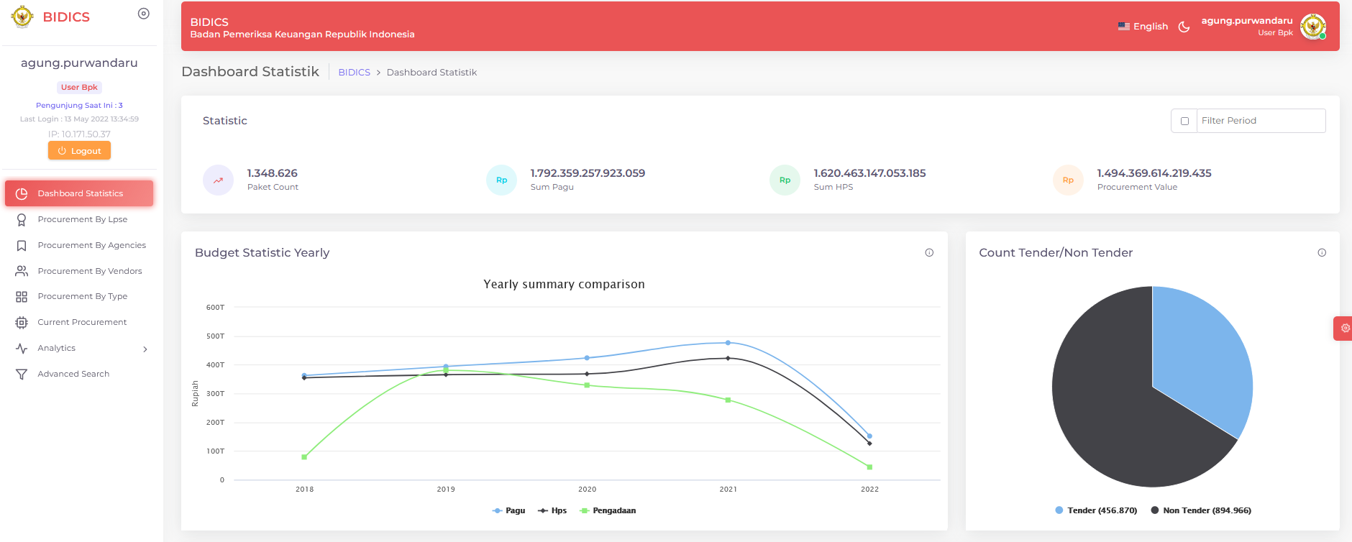
BIDICS Dashboard

Slide 12
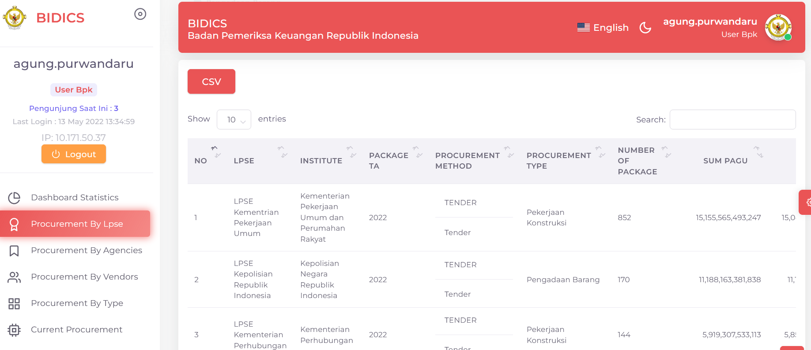
e.g. All e-tendering activities held by central and local governments

Slide 13
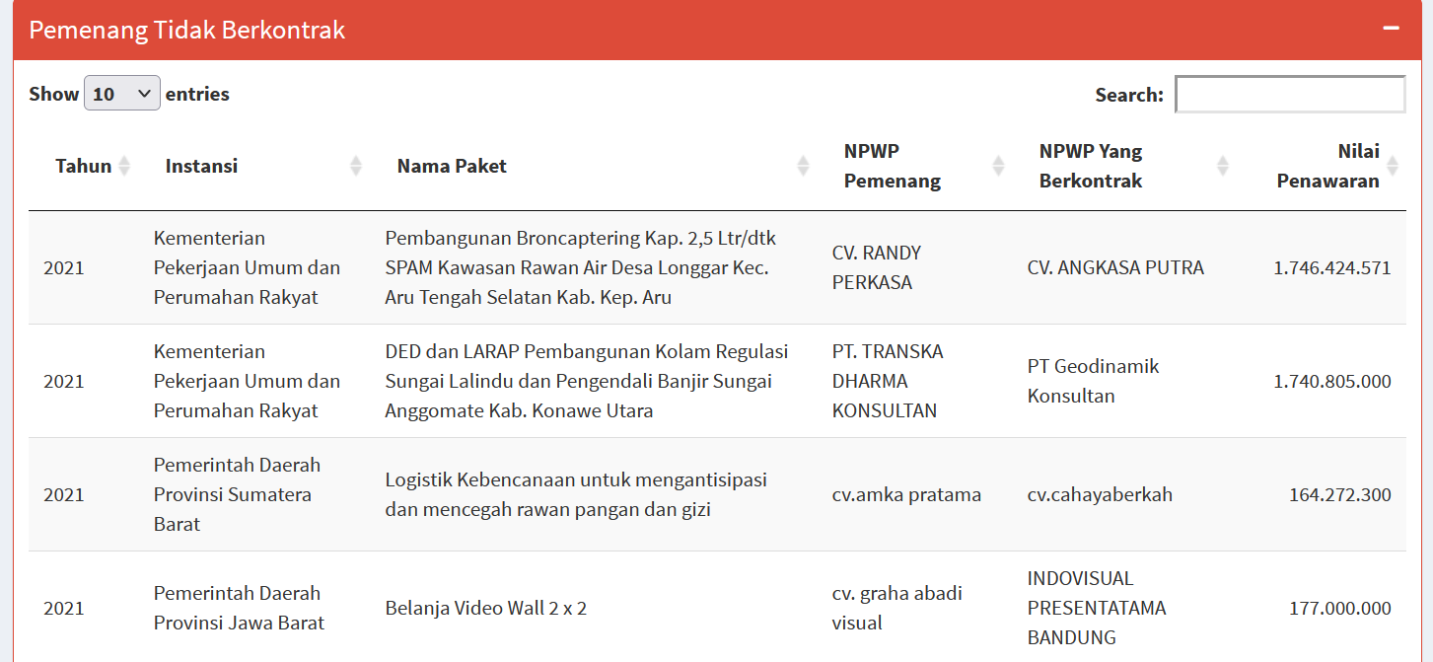
e.g. Contract is not awarded to bidding winner

Slide 14
e.g. Winner is not the lowest bidder

Slide 15
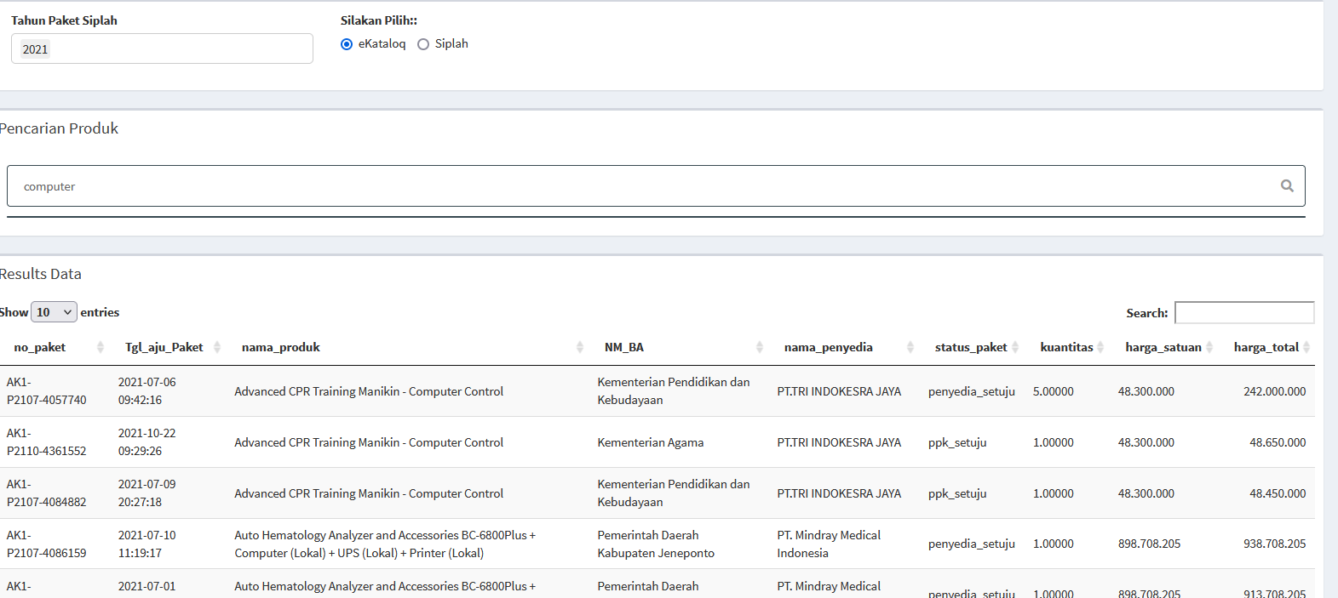
e.g. Winner is not the lowest bidder
e.g. e-Catalogue product search

Slide 16
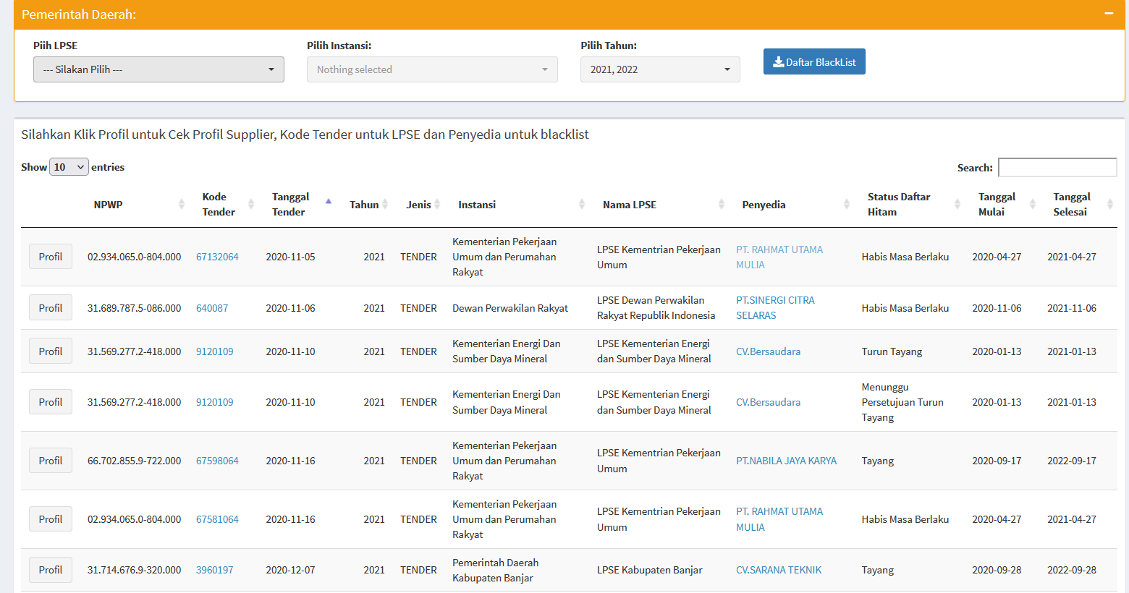
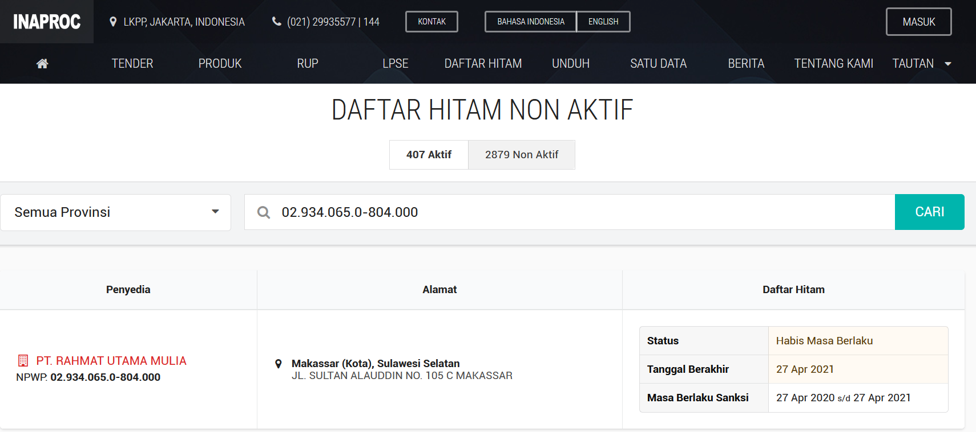
e.g. Blacklist supplier

Slide 17
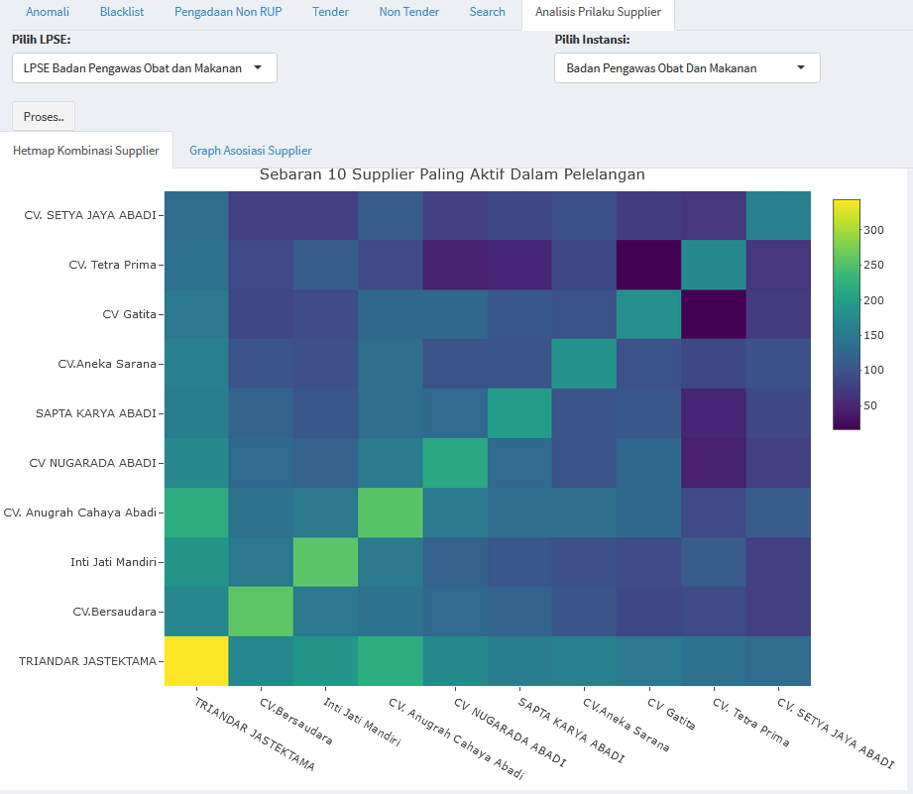
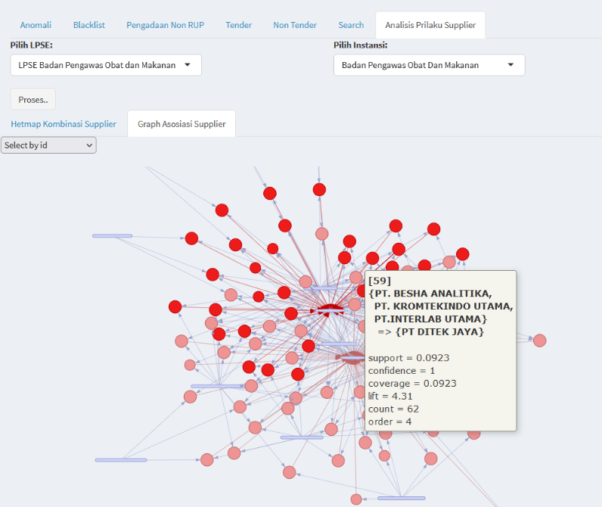
e.g. Supplier Behaviour Analysis
Suppliers Activity Heatmap
Supplier Association Graph

Slide 18
THANK YOU

