Slide 1
WGITA Reporting Dashboard Updates
Agenda 14
31st Annual WGITA meeting
23 May 2022

Slide 2
Achievements in WGITA Work Plan 2017-19
developed in 2019
IFPP document completed : GUID 5100 : Guidance on audit of information systems (led by SAI India)
Non-IFPP documents completed :
Data analytics Guidelines (led by SAI Indonesia)
General Capacity Building Requirements for conducting IT Audits in SAIs (led by SAI South Africa).
Roadmap for Development of future GUIDs under 5100 Series (led by SAI Pakistan) was completed.

Slide 3
WGITA Work Plan 2020-2022: Knowledge Development Activities
# | Name of the project | Lead SAI | Project status | Timelines for completion
1. | Cyber security and data protection challenges | Mexico | Content development under progress. | February 2023
2. | Audit of IT Management functions including IT Governance, Contract Management and Sustainability | India | Content development under progress. | December 2022
3. | Performance Evaluation of Information Systems | Pakistan | Team building for content development under progress. | December 2023
4. | Review of previous work done for their current worthiness | USA | Completed | NA

Slide 4
WGITA Work Plan 2020-2022: Knowledge Sharing Activities
# | Name of project | Project Lead | Project status
1. | Quarterly Webinars on IT Audit Topic | USA, India | On-going Webinars conducted on : IT and Cybersecurity Audit Work- US GAO Enterprise-wide Audit Process and Knowledge Management IT System – SAI India Auditing Legacy IT systems – US GAO
2. | Maintenance of IT Audit Database in the WGITA Webpage | Bhutan | On-going 266 audit reports have been shared through WGITA website.

Slide 5
WGITA Work Plan 2020-2022: Capacity Building Activities
# | Name of project | Project Lead | Project status
1 | Development of Global Curriculum for IT Audit | India | Final document with Quality Assurance certificate will be submitted to INTOSAI Governing Board in November 2022.

Slide 6
WGITA Work Plan 2020-2022:
August 2020
Project proposals approved in August 2020.
2022/ 2023
Projects to be completed by 2022/ 2023.

Slide 7
Other Ongoing Activities
Revision of GUID 5101 (Audit of Security of Information Systems) led by SAI India.
Updation of WGITA-IDI Handbook on IT Audit, led by US GAO

Slide 8
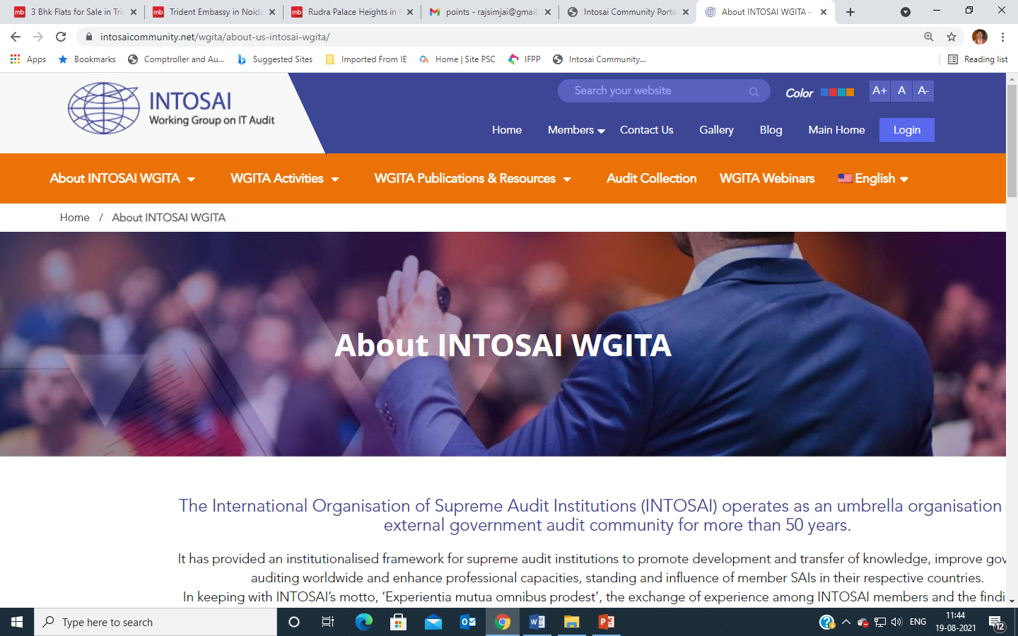
WGITA Website
https://www.intosaicommunity.net/wgita/

Slide 9
Updates & Information
News & Events
31st WGITA meeting and seminar
Membership & Contacts
New members- SAIs of Azerbaijan, Montenegro and Maldives
WGITA Meeting materials
31st WGITA meeting
Knowledge Centre
The Global Curriculum on IT Audit
Videos/Presentation on WGITA Seminars
WGITA seminar on ‘Auditing eProcurement Systems’
IT Audit Database
266 IT audit reports uploaded

Slide 10
Thank You

