Slide 1
WGITA
Project 7: Development of Global Curriculum for IT Audit
Responses

Slide 2
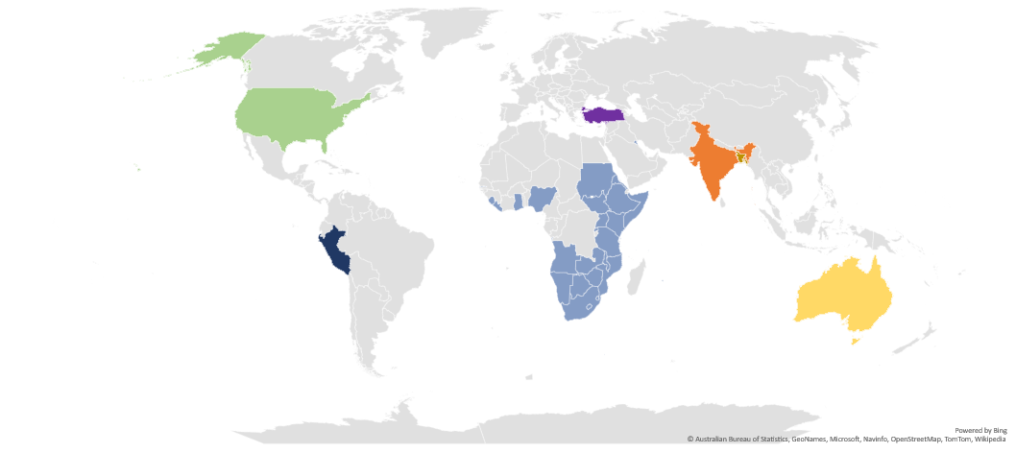
WGITA Project 7 is led by India with AFROSAI-E, Bangladesh, Kuwait, Turkey, Peru, USA and Australia as Members.

Slide 3
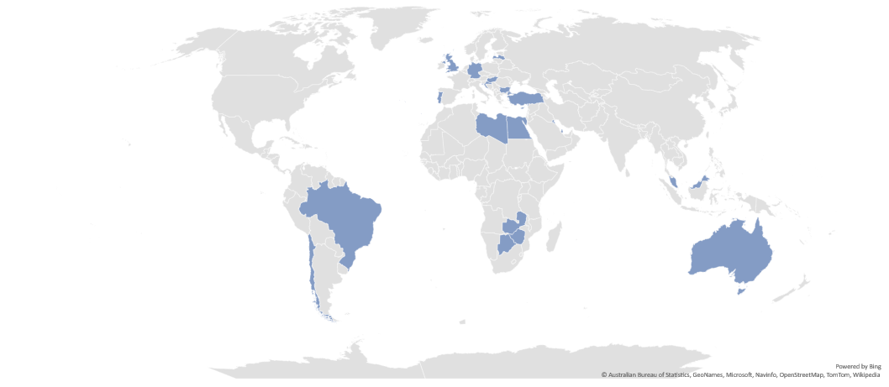
Responses received from 22 Countries:

Slide 4
IT Systems development models:
1. Internal 2. Bespoke or customization through a System Integrator 3. Procurement of off the shelf products

Slide 5
Existing governance and management framework for IS acquisition and development

Slide 6
IS policies and procedures set by: Governmental framework/ international standards

Slide 7
Exclusive pools of IT auditors or other auditors are trained for IT audits also

Slide 8
Data analytics as a separate stream of expertise

Slide 9
IT auditors: Separate recruitment or specialization based on training and experience?

Slide 10
Certification for IS Auditors: CISA or any other?

Slide 11
IT systems type: ERP systems/ Financial accounting and management/ Social Sector Programs and Beneficiary Management IT Systems/ Transaction processing systems and E-Governance Systems for service delivery/ MIS/ others

Slide 12
Data analytics also used for substantive testing of IT controls or to support the objectives of a variety of audits

