Slide 1
WGITA Project 2 update
SAI India

Slide 2
What we set out to Do

Slide 3
Guidance doc on IT Audit Management
Covers audit of
IT Governance
IT Outsourcing
IT Sustainability
All WGITA/ frameworks literature on the related domains
IT Audit Handbook
GETIT
ISOs
COBIT 2019

Slide 4
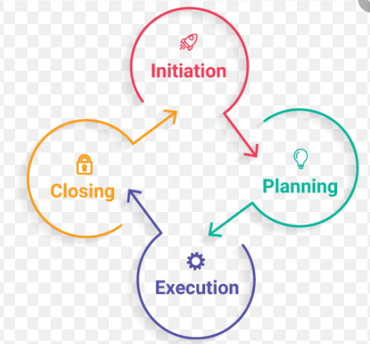
Project Aim
Content
Project Stages
Project Tasks
--Scan audit reports and identify risks and
build audit matrices
-- Identify audit issues specific to Sustainability of IT Solutions
--Identify and document good practices as per frameworks and standards
Stage 1- PID
Stage 2 – Exposure Draft
Stage 3- Feedback from WGITA members
Stage 4- Preparation of Final Draft by April 2022
An Audit Guide- focusing on IT Governance, Outsourcing and Sustainability of Solutions +
Good practices across legal and tech contexts to aid reco
Map domain elements across standards n frameworks
Study Reports to identify commonly commented upon areas/ risks
Good practice case studies
Audit Programs

Slide 5
Structure of the Guidance document

Slide 6
Guidance Template
3 Sections –A, B , C
Risks
Matrices
Best Practices
A1- risk areas to address while Auditing IT Governance
Align , Plan and Organise
Build Acquire and Implement
A2 – Risks embedded in IT Outsourcing
When an entity engages in Cloud Services
When an entity contracts vendors to run core Business functions running on an IT platform
A3 – Risks re: sustainability of IT Solutions that an Auditor needs to consider
While Planning an IT acquisition
When new technology adoption picks up in the entity’s environment

Slide 7
Guidance Template
B 1, 2, 3- Matrices/ programs for
Auditing IT Governance – System acquisition and Implementation
Auditing IT Outsourcing – Cloud services, core functions
Sustainability issues for IT systems
C1, 2, 3- Best practices noted and recommendations made in public audit engagements
IT Governance
IT Outsourcing – Cloud services and Core Functions
Sustainability of IT Solutions
Call for inputs along with circulation of exposure draft

Slide 8
Project work update
Guidance Doc

Slide 9
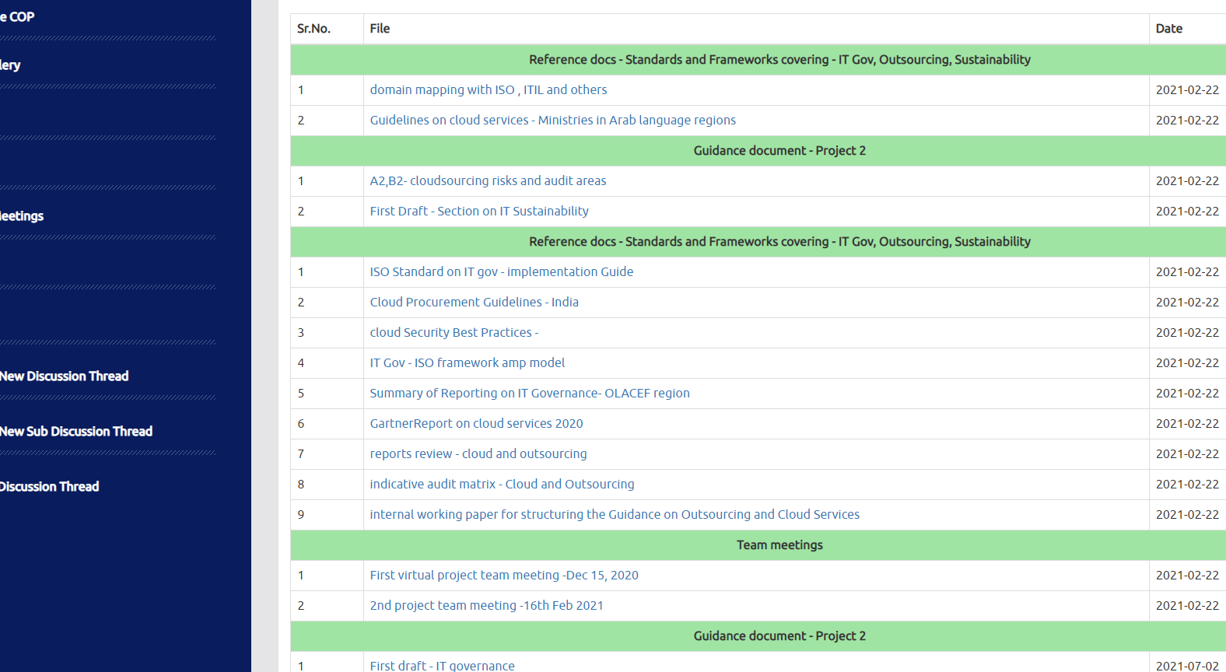
Collaboration on the INTOSAI Community Portal

Slide 10
Guidance Doc on IT Management
Section | Content | Status of work
A | Risks
A1 | Risks re: IT governance | First draft and comments
A2 | Embedded in IT Outsourcing – including cloud services | First draft on cloudsourcing risks
A3 | Risks re: Sustainability of IT solns | First draft and comments
B | Audit Programs/ matrices
B1 | IT Gov- System acquisition n implementation | -
B2 | Cloud services, O/s core functions | Audit matrix on Cloud services
B3 | IT Sustainability | First draft done
C | Good practices and recommendations in audits
C1 | IT Gov | -
C2 | Outsourcing | - Some reported findings collected
C3 | IT Sustainability | -

Slide 11
Content development
The first drafts for all Sectional tracks in three related domains covering Risks have been completed
Comments and discussions on these drafts have taken place
First drafts for Section covering Audit matrices have been done and circulated for comments in two domains except IT Governance
First drafts covering Section on good practices, recommendations on related domains are presently being drafted
SAI Qatar and Ecuador team members supported content references with a scanning exercise on audit reports, legislations, cloud adoption in ARABOSAI region, OLACEFS and English language reports I public domain.
SAI India team has reached out to SAI Bhutan and accessed EUROSAI ITWG websites for identification of good practices found in public audits

