Slide 1
INTOSAI KSC
INTOSAI Working Group on Big Data (WGBD)
National Audit Office of China
Department of Electronic Data Audit
Zhao Chen
September 1, 2021
SAI CHINA

Slide 2
01
What we are facing
◎ big data technology revolution
◎ our responsibilities

Slide 3
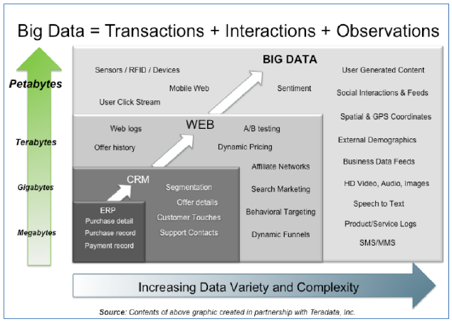
WGBD
We are in the Age of big data
Big Data is everywhere.
Big Data has transformed our daily life, also the industries. It has become very important in many country’s national strategy .
Big Data is a new revolution, It will transform our auditing work surely.
Normally, big data is scaled by PB\EB\ZB\YB.

Slide 4
WGBD
Auditing responsibilitie
In 2014, the 69th UN Assembly:
SAIs assume a proactive role in aiding governance to promote transparency,
effective oversight and control.
In 2015, the UN adopted the 2030 Sustainable Developmnent Goals, defining 17 goals.
The SDGs cover basic development rights for all, such as no poverty, no hunger, quality education, clean water, etc.
The SDGs also connect to global governments’ long term strategy to change energy and consumer patterns and address growing environmental challenges.
SAIs need to follow closely the implementation and outcome of SDGs in their countries.
Big data auditing can help SAIs better perform their duties.

Slide 5
WGBD
BIG DATA AUDITNG is a global topic with high concerns
One of the main themes in 2019’s 6th Global Audit Leadership is “Big data and National audit”, which includes the following three sub-themes:
Big data auditing system design
Big data auditing practice
The innovation of big data auditing management
Theme I of INCOSAI XXIII in 2019 is “Information Technology for the Development of Public Administration, which includes the following two sub-themes,
I.1 Electronic data application for public administration development
I.2 The role and function of big data in SAIs’ activities
These discussions focused on how data application can help to advance public administration, with much attention paid to Features / Role & Function / Challenges & Tactics of big data auditing.

Slide 6
02
Introduction of the WGBD
◎ The strategic goals
◎ members
◎ focus field

Slide 7
WGBD
The strategic goals of WGBD
Identify the opportunities and challenges that SAIs are facing in a big data world to provide recommendations to SAIs.
Goal
1
Summarize the know-how, experience and good practices concerning big data audit, and develop guidelines, research reports, to share knowledge and help SAIs to boost relevant capacities.
Goal
2
Goal
3
Strengthen bilateral, regional cooperation among INTOSAI Members in big data audit.

Slide 8
WGBD
Members of WGBD
Chair
China
Vice Chair
United States of America
Members:
Austria, Bangladesh, Bhutan, Brazil, Denmark, Ecuador, Finland, India, Indonesia, Mexico, the Netherlands, New Zealand, Norway, Pakistan, Russian Federation, Thailand, United Kingdom, Fiji, the Republic of Korea, Argentina, Kuwait, Portugal, Philippines, Peru, Senegal ,Turkey, Georgia,Estonia,France,Ukraine,Belgian
New Member
Slovak Malaysia
Observers
lreland Bulgaria AFROSAI-E ECA Vietnam

Slide 9
Focus field of WGBD
1. Basic theory framework
1.1 Big data auditing Challenges and Opportunities
1.2 Big data auditing concept, including audit
aim, data scope
1.3 Roadmap leading to big data auditing
2. Auditing technologies innovation
2.1 Integrate and standardize multi-source,
heterogeneous data 2.2 Big data storage architecture 2.3 Big data analysis techiques
1
2
4. Auditing management revolution
4.1 Setting up across-department cooperation
mechanism for data collecting 4.2 Reform the auditing organiztion mode 4.3 Auditing risk and quality control
3. Big data auditing practices
3.1 Promote the sustainable development
through big data auditing 3.2 Anti-fraud auditing in big data era 3.3 Improve data transprancy and sharing
3.4 Data security and confidentiality
4
3

Slide 10
03
what we are doing
◎ meeting and seminars
◎ Research projects and publications
◎ communication and exchanges

Slide 11
1. Meetings and seminars
 | members, observers | participants | speakers | Theme
1st meeting | 19,1 | 18 | 13 | Chance and Challenge in big data era
2nd meeting | 27,3 | 20 | 14+3 | Big data auditing practices and cases
3rd meeting | 28,3 | 51 | 14+1 | Changes on audit management in a big data environment
4th meeting | 33,3 | above 100 | 11 | Auditing technology Innovation
5th meeting | 35,5 | TBD | TBD | Audit quality control in a big data environment

Slide 12
WGBD
Annual meetings: 2020-2022
Working group meetings will be held annually to discuss WGBD work plan, review research progress and other related matters.
A seminar on innovation and application of big data audit analysis techniques was held in 2020.
annual meeting
innovation and application
A seminar on working mechanisms of big data audit will be convened in 2022.
A seminar on audit quality control in a big data environment will be held in 2021.
quality control
working mechanisms

Slide 13
WGBD
2. Research projects and publications
Publications:
1. A summary of the big data audit cases and practices shared by member SAIs
2.In 2019, the WGBD compiled the case study publication, World Practice of Big Data Auditing in Promoting Sustainable Development.
The Secretariat of the WGBD distributed questionnaires to the member SAIs at this year and responded by a total of 18 SAIs. After further analysis and research, a research report, Present Status and Future Development Prospect of Big Data Audit in Supreme Audit institutions was completed.
Research Projects:
1. Auditing Technologies Innovation has been launched in 2019 and SAI Indonesia is the project leader. This project aims at helping SAIs build their capacity to enable big data analytics to increase the quality of the audit process and results. Now SAI Indonesia has finished the draft.
2. Guidance on Conducting Audit Activities with Data Analytics has been laduched in 2019 and SAI China is the project leader. Now SAI China has finished the draft.
case
study
research projext
summary
&sharing
Notes:
It contains the audit cases of the United States, Finland, the United Kingdom, China and other countries about the big data audit in promoting sustainable development. It introduces the whole process from data collection, data analysis to data application in detail. And it is the first big data audit case compilation in the world.

Slide 14
WGBD
3. communication and exchanges
The WGBD secretariat exchanged about 2,700 emails with its member SAIs and international organizations
Cooperation between relevant regional organizations and member SAIs have been strengthened.
The WGBD has established a contact mechanism with EUROSAI ITWG to exchange and share research updates in the field of IT-audit.
16 new members
4 new observers
Now, the WGBD has 35 members and 5 observers.
In the 5 years of 2016-2021

Slide 15
Thank you！
Email : intosai-wgbd@audit.gov.cn

