Slide 1
ISACA PRESENTATION TO
27th MEETING OF INTOSAI WGITA
Joe barkley, global partnerships manager
April 17, 2018

Slide 2

ISACA’s PURPOSE AND PROMISE
PURPOSE:
Help you realize the positive potential of technology
PROMISE:
Inspire confidence that enables innovation through technology

Slide 3





Our Values
GLOBAL NONPROFIT PROFESSIONAL ASSOCIATION FOR INDIVIDUALS AND ENTERPRISES
We are
We are
ONE
innovative
SERVING MORE THAN
450,000
ENGAGED PROFESSIONALS
135,000+
Members in
190 COUNTRIES
217 CHAPTERS
WORLDWIDE
We are
We are
authentic
dedicated
7+
INDUSTRY-LEADING
CONFERENCES
1,000+
KNOWLEDGE ASSETS
Notes:
WE ARE ONE
We care deeply about people and recognize that employees and members are our extended family who we must support and nurture.
WE ARE ACCOUNTABLE
We stand behind the work we do and the contributions we make. This is the cornerstone of our success.
WE ARE DEDICATED
We are unfailingly passionate about ISACA. We are dedicated to maximizing its influence and impact globally. We are committed to lifelong learning and volunteering as part of our professional growth.
WE ARE AUTHENTIC
We operate with honesty, integrity and the highest level of professionalism in everything we do. Trust and respect is our operational foundation.
WE ARE INNOVATIVE
We thrive on being creative and innovative. We are empowered to make decisions and take measured risks at all levels of the organization.

Slide 4

Global network of passionate volunteers
2,800+ global chapter leader volunteers
More than 1,200 people served in 58 additional types of volunteer opportunities in the past year
Nearly 400 volunteer speakers participated in ISACA’s global CACS and CSX conferences

Slide 5

Cybersecurity TRENDS

Slide 6
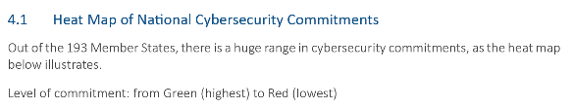
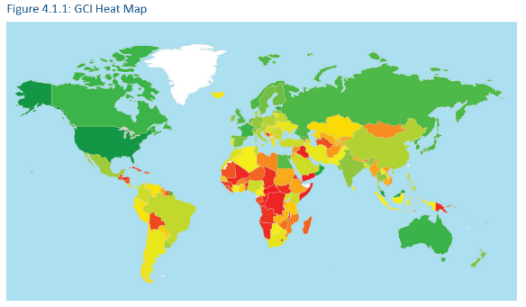
Cybersecurity agenda strengthening globally, but room for improvement remains
The 2017 Global Cybersecurity Index (GCI) measures the commitment of Member States to raising awareness about cybersecurity
Initiating stage refers to the 96 countries (i.e., GCI score less than the 50th percentile) that have started to make commitments in cybersecurity
Maturing stage refers to the 77 countries (i.e., GCI score between the 50th and 89th percentile) that have developed complex commitments, and engage in cybersecurity programs and initiatives
Leading stage refers to the 21 countries (i.e., GCI score in the 90th percentile) that demonstrate high commitment to cybersecurity and awareness
Source: ITU; 2017 Global Cybersecurity Index

Slide 7
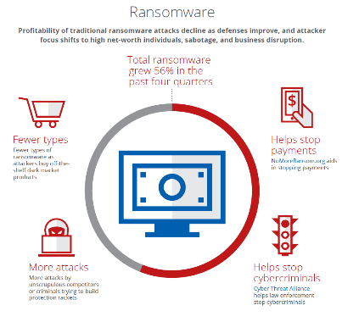
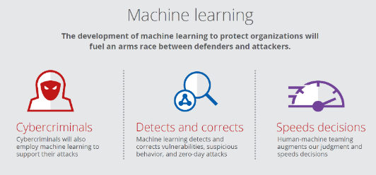
2018 Threat predictions: McAfee Labs
A year for machine learning, ransomware to take center stage
Machine learning ‘arms race’ switching into higher gear as machine learning becomes more prominent and valued as a security component
Ransomware remains prominent, but will evolve in the face of improving defense, striking less ‘traditional’, more profitable targets
Source: McAfee; 2018 Threat Predictions; McAfee Labs, November 2017

Slide 8
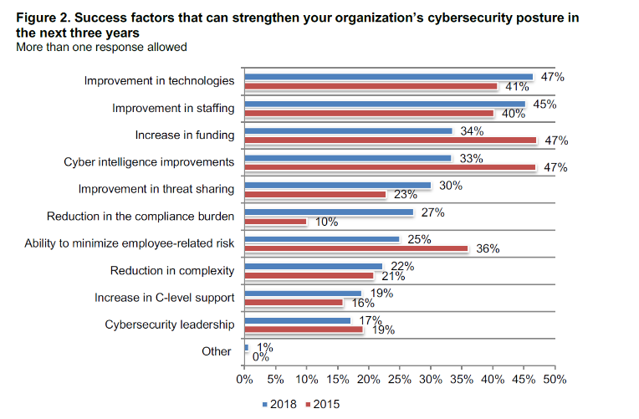
Business focus on cybersecurity is shifting
Funding, employee risk and better cyber intelligence are shrinking in importance
To improve cybersecurity posture in the coming three years, companies should invest in improving technologies and staffing
Source: Ponemon Institute; 2018 Study on Global Megatrends in Cybersecurity; Ponemon Institute and Raytheon, February 2018

Slide 9
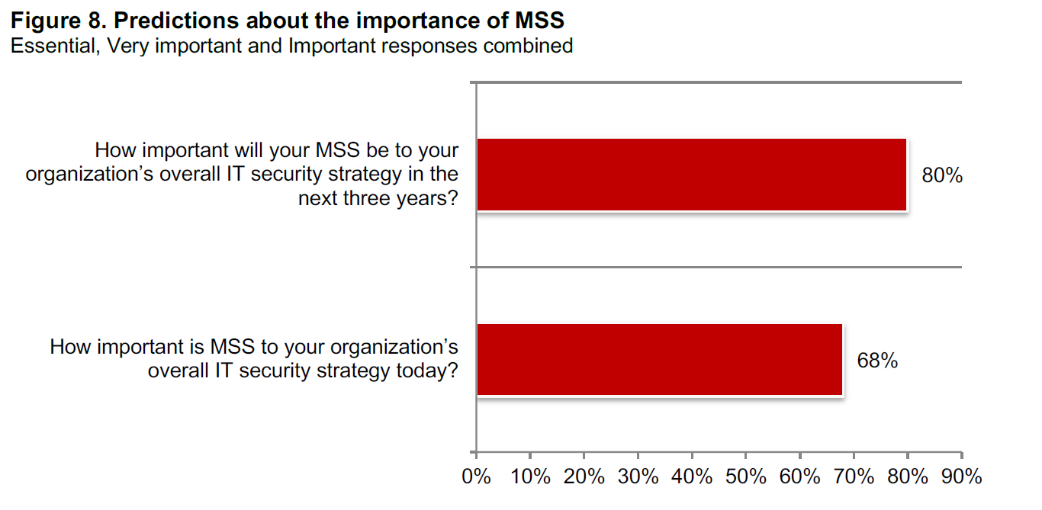
Managed Security Services (MSS) usage will increase
Lack of skilled in-house staff very likely to drive companies towards increased use of mss in their overall it security strategies
Source: Ponemon Institute; 2018 Study on Global Megatrends in Cybersecurity; Ponemon Institute and Raytheon, February 2018

Slide 10

What is the cyber-shock absorber enterprises need? Resilience (part i)
PWc’s 2018 global state of information security survey (GSISS) results show that investments in infrastructure and training that are resilient to cyber shocks will fare best
Leaders must assume greater responsibility for building cyber resilience…
only 44%
of GSISS respondents said their Boards are active in the enterprise’s overall security strategy
  Despite many enterprises’ best efforts, many boards still see this as an IT problem, not an enterprise problem

Slide 11
What is the cyber-shock absorber enterprises need? Resilience (part ii)
PWc’s 2018 global state of information security survey (GSISS) results show that investments in infrastructure and training that are resilient to cyber shocks will fare best
Organizations must dig deeper to uncover risks; having the right leadership and processes in place is critical, but many enterprises are only just beginning to do so
GSISS survey results bear this out, as the survey shows areas like IoT risk ownership scattered across the business ecosystem
Some surveyed said the responsibility for IoT risk
fell to the CISO (29%)
Others felt the
engineering staff (20%)
or
Chief Risk Officer (17%)
should be responsible
Source: PWC; 2018 Global State of Information Security Survey report; December 2017

Slide 12

What is the cyber-shock absorber enterprises need? Resilience (part iii)
PWc’s 2018 global state of information security survey (GSISS) results show that investments in infrastructure and training that are resilient to cyber shocks will fare best
Cybersecurity executives remain absent in many organizations
  Only 52%of GSISS respondents said their enterprise had a CISO;
  45% said their enterprise had a chief security officer,
  and only 47% said they employed dedicated security personnel to support internal business operations
Source: PWC; 2018 Global State of Information Security Survey report; December 2017

Slide 13

There is a definite need for greater information sharing and coordination within industries, as
only 58% of survey respondents indicated they formally collaborated with industry colleagues
Source: PWC; 2018 Global State of Information Security Survey report; December 2017

Slide 14
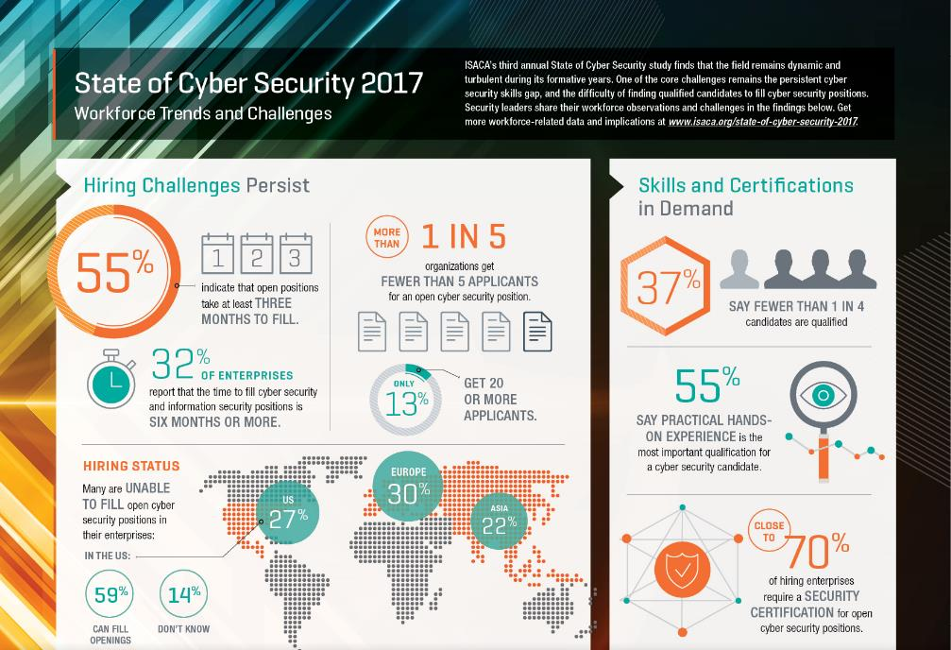
Source: ISACA’s State of Cybersecurity 2017: Current Trends in Workforce Development

Slide 15
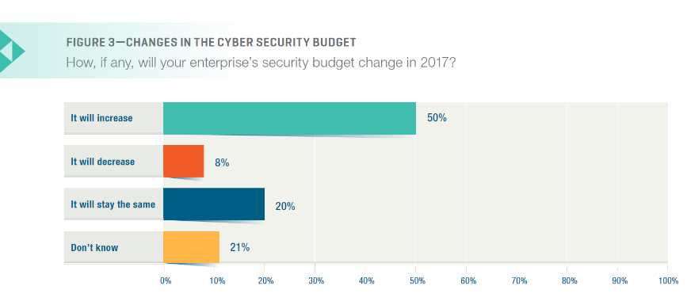
Cybersecurity Budgets are still expanding, but more slowly
Half of the enterprises represented by the survey respondents anticipate a growth in their cyber security budget over the next year. Although this is an encouraging sign and points to the fact that cyber security is increasingly being seen as an investment area, the rate of growth appears to have slowed. Specifically, for 2016, 61 percent of survey participants indicated expected budget growth; for 2017, only 50 percent report an expected increase.
Source: ISACA’s State of Cybersecurity 2017: Current Trends in the Threat Landscape

Slide 16
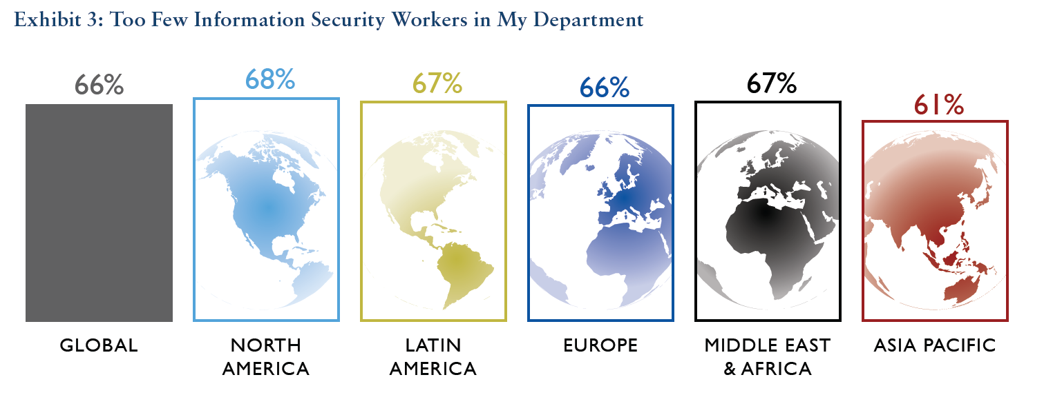
Cybersecurity understaffing remains an issue
1.8 million-worker shortage anticipated by 2022 (per [isc]² estimates)
Source: (ISC)²’s 2017 Global Information Security Workforce Study

Slide 17
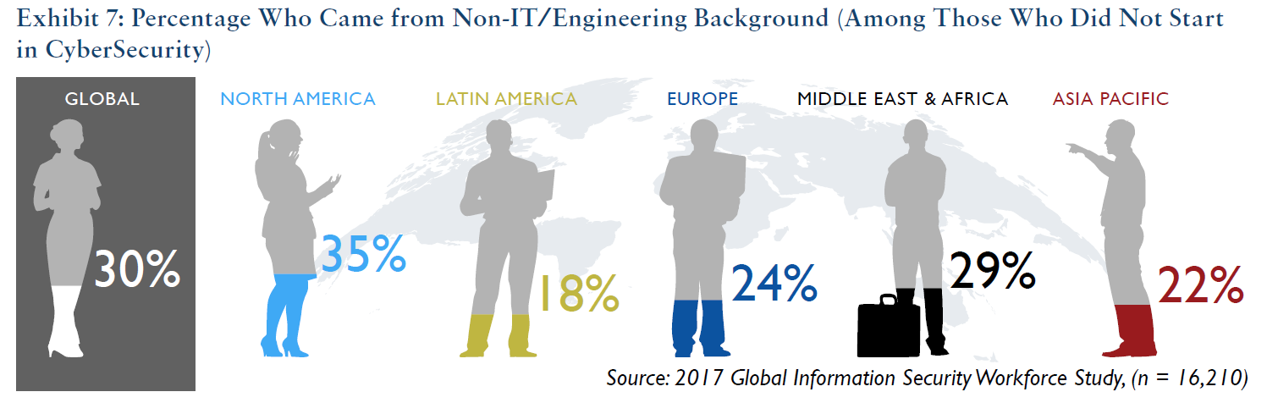
More than one way to become a cybersecurity professional
Diverse array of professionals finding their way to cybersecurity; arriving from fields as diverse as business, marketing, finance, or accounting
Source: (ISC)²’s 2017 Global Information Security Workforce Study

Slide 18
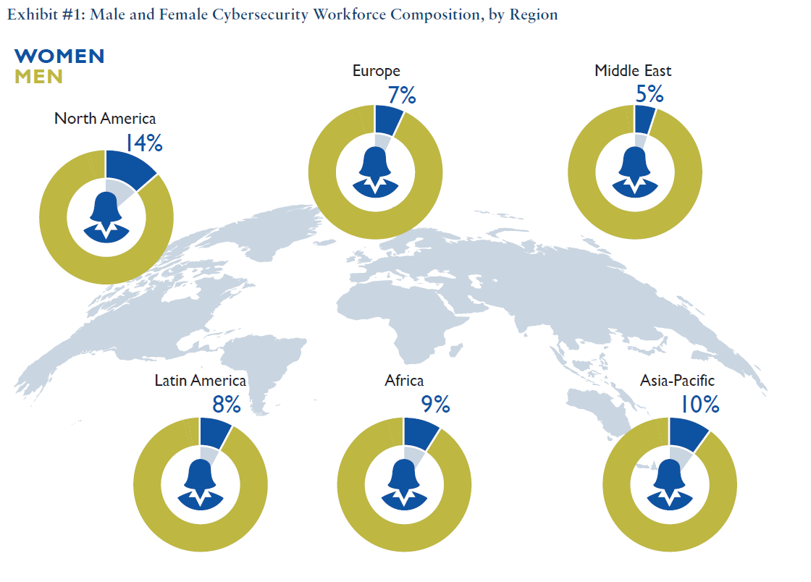
Gender parity in cybersecurity remains an issue
Source: (ISC)²’s 2017 Global Information Security Workforce Study

Slide 19
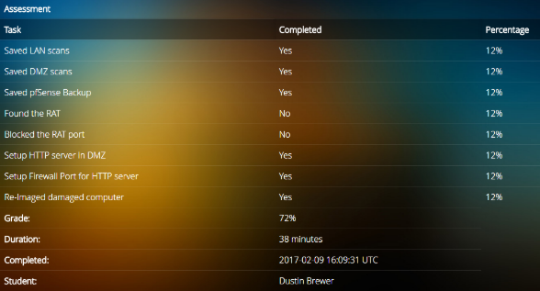
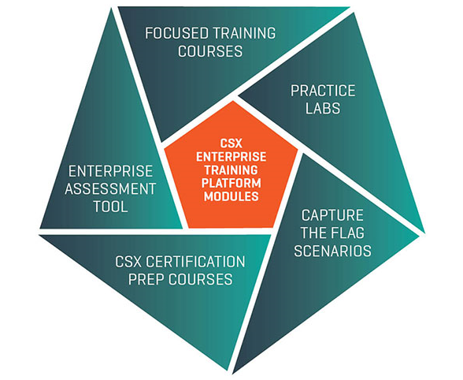
CSX Update—CSX TRAINING PLATFORM
Launched CSX Training Platform for enterprises in April 2017
Individual offerings being piloted now

Slide 20
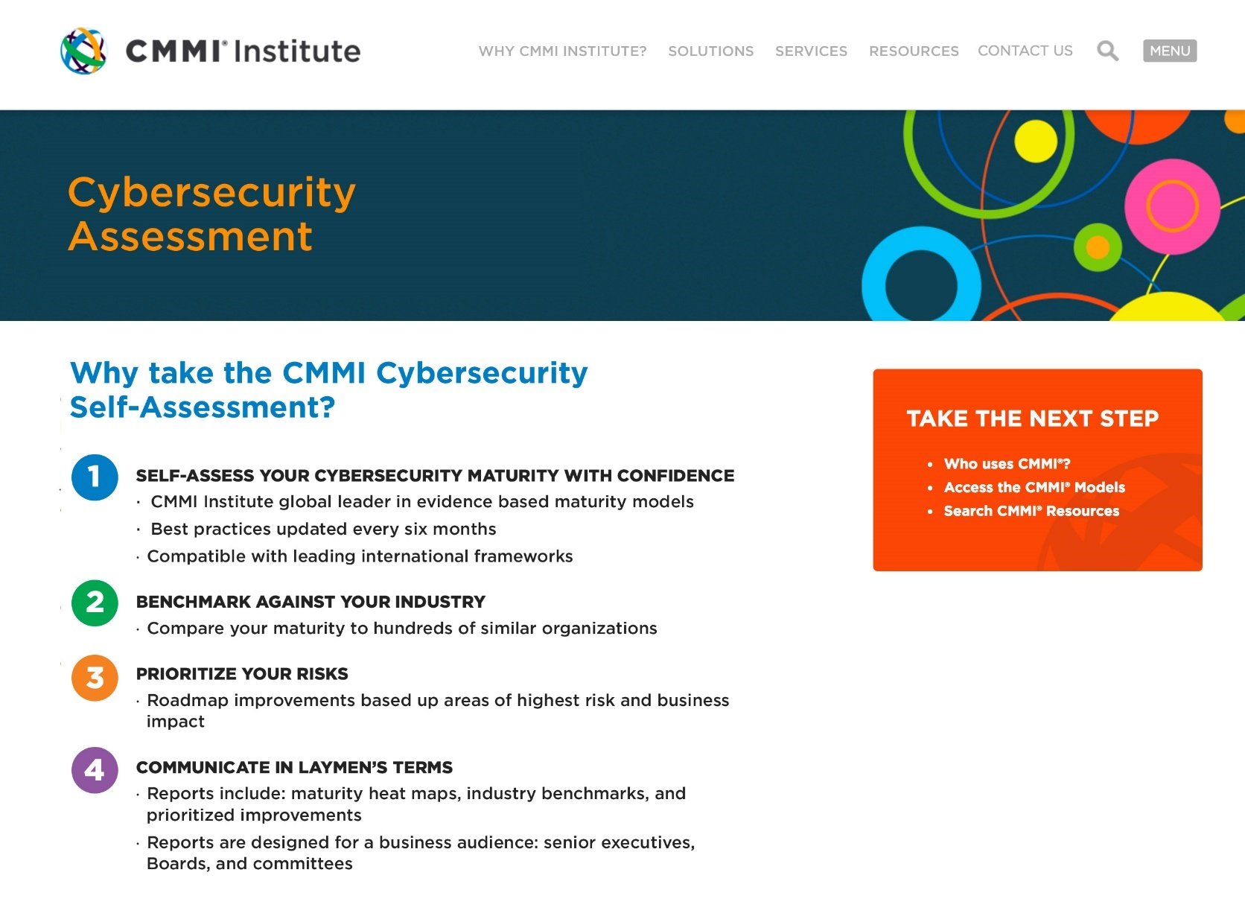
CMMI INSTITUTE UPDATE
ISACA acquired CMMI Institute in 2016
CMMI Institute is the home of the Capability Maturity Model Integration (CMMI)—V2.0 coming next year
CMMI recently launched CMMI Certified Professional, a new practitioner certification for operational excellence
ISACA and CMMI launched COBIT 5/CMMI Practices Pathway Tool
In 2018, CMMI will launch a Cybersecurity Capability Assessment

