Slide 1
Audit on IT System Management
-Focusing on how to audit IT systems -
Workshop Paper on
The 13th Working-level Meeting for the SAIs of China, Japan, and Korea
July 10-12, 2017

Slide 2
A recent trend of Japanese IT audit cases
---Angles and Areas---
For 27th WGITA meeting at Sydney
SAI-JAPAN
Board of Audit of Japan
Daisuke Sakuraba
Auditor
Agricultural Infrastructure Audit Division, ASTRA

Slide 3
Before starting
Daisuke Sakuraba
means “Minister of Cherry garden”
From ASTRA
Means “IT Audit Skill-up TRAining team”
Has educated 46 members in 1,244 staffs
Have attended WGITA meetings since 2006
You may know Eri, Kae, Michiko, Shimon, Fujii
and Tommy
→ Remember ASTRA please !!

Slide 4
Today’s goal
Sharing our characteristic IT audit results from recent special reports
Showing our angles for IT audit with mapping on WGITA’s context

Slide 5
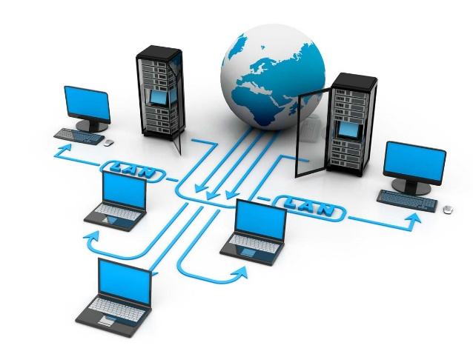
Contents
Recent large scale of IT projects and incidents in Japanese Gov.
Our special audit reports
Recent trend of SAI-Japan’s audit results
-Comparisons with WGITA–IDI handbook on IT audit for SAIs-
Conclusion

Slide 6
Recent large scale of
IT projects and incidents in Japanese Gov.

Slide 7
1. Recent large scale of IT projects and incidents of Japanese gov.
New Social Security and Tax Number System (2017)
Leaks of personal information from the Japan Pension Service (2015)

Slide 8
New Social Security and Tax Number System(SSTNs)
【Context】
Before this system, different ID numbers for social security and tax were given and operated by different agencies and their own systems.
Key tags were only address and name, accordingly IDs were
not perfectly coordinated
Creating brand new system would cost too huge money because more than 5000 entities should renew the systems
Accordingly, decided to build a only coordinating system with creating new common ID number tying both of the social security data and tax information

Slide 9
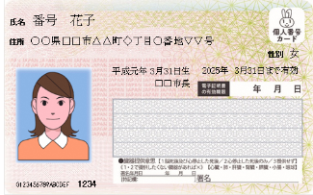
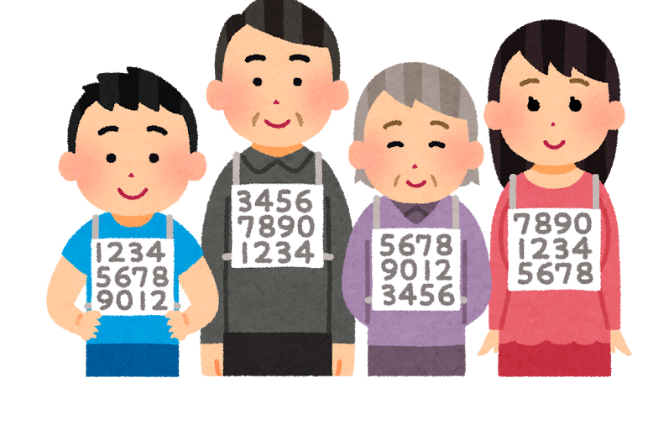
【New System】
Budget : 420 million $(2014)
570 million $(2015)
460 million $(2016) total 1.45 billion $
By 2017, they were building cooperating system among
190 systems of 170 organizations
Issuing ID card with the photo if you want

Slide 10
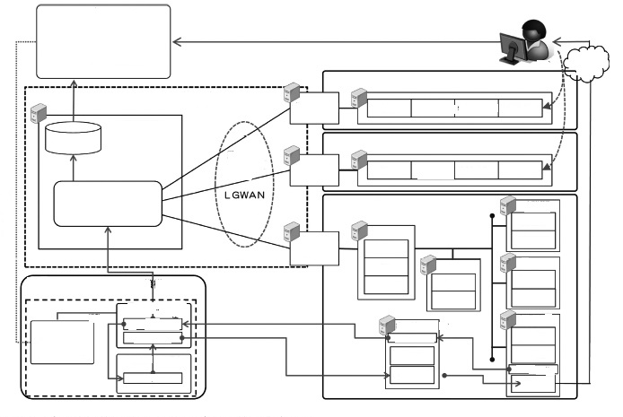
Structure of SSTNS
Complicated cooperation among huge number of stake holders
Citizen
Portal Site
Internet
Notification
Entity A
Gov.
Shared System
system
Number, personal data…
Core System
storage
Entity B
system
Number, personal data,…
Connecting by codes
Local Governments
Welfare Data
Server
system
IT System of inter-LGs.
Number
Data
Tax Data
Codes
Identification
System
system
Address Data
My Numbers
Number
Data
Codes

Slide 11
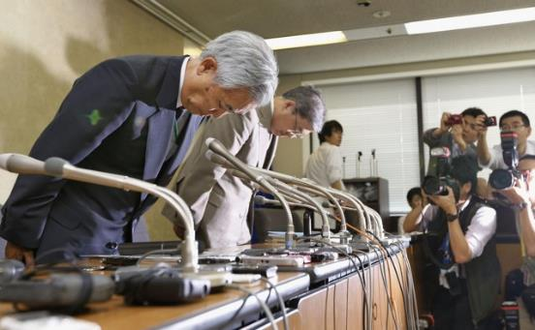
Leaks of personal information from the Japan Pension Service
In May 2015, personal information of about 1,250,000 people related to the National Pension was leaked by the attack of Advanced Persistent Threats
The Japan Pension Service has already given new numbers to the people and several improvement plans were conducted
The restoration of the reliability on the system and the foundation itself should be needed

Slide 12
We conducted special audits
on these special project and incident !!

Slide 13
2. Our special audit reports

Slide 14
2. Our special audit reports
New Social Security and Tax Number System(SSTNs)
SSTNs operations in local entities
Reports on the IT projects in local areas funded by the grants related to the introduction of The Social Security and Tax Number System
(Special report to the Diet and the Cabinet, FY2017)
SSTNs coordination in central government
Reports on the progress of the arrangement of relevant IT systems related to the introduction of The Social Security and Tax Number System
(Special report to the Diet and the Cabinet, FY2017)

Slide 15
Leaks of personal information from the Japan Pension Service
After the information leak
Reports on the state of implementation of information security policies concerning the personal information within the National Pension System and the impacts on the operations of the Foundation of the Japan Pension Service made by the information leaks
(Special report to the Diet and the Cabinet, FY2016)

Slide 16
SSTNs operations in local entities
Reports on the IT projects in local areas funded by the grants related to the introduction of The Social Security and Tax Number System
(Special report to the Diet and the Cabinet, FY2017)
【Audit findings (Excerpt) 】
Too tight schedules and less know-how tended to cause operational delays
The specification sheets for 1,173 systems (28.0%) in MIC and 3,201 systems (27.9%) in MHLW totally lacked the the requirements for results

Slide 17
【Recommendations(excerpt)】
More guidance concerning specification sheet, estimate sheet, and schedule planning know-how for system tests should be provided with the staffs of local governments
To prevent occurrence of delay, more careful supports and supervisions to the local government staffs by relevant ministries are needed

Slide 18
SSTNs coordination in central government
Reports on the progress of the arrangement of relevant IT systems related to the introduction of The Social Security and Tax Number System
(Special report to the Diet and the Cabinet, FY2017)
【Audit findings (Excerpt) 】
Time-lag in data synchronization and insufficient utilization of intermediate servers were likely to reduce the effectiveness of SSTNs
Lack of the necessary data item for coordination in the guidance caused and 1 year delay of start in 127/190 systems of 127/170 entities
Lack of identification of necessary data caused 1 year delay of cooperation starting in 127/190 systems

Slide 19
【Recommendations(excerpt)】
More careful reviews on operation process, more correct requirement definition, and more appropriate information sharing procedures with contractors should be required.
The directing ministries must instruct more communication and more information sharing among relevant entities.

Slide 20
After the information leak
Reports on the state of implementation of information security policies concerning the personal information within the National Pension System and the impacts on the operations of the Foundation of the Japan Pension Service made by the information leaks
(Special report to the Diet and the Cabinet, FY2016)
Security polices were not updated in appropriate timing before the incident
Meaningful information collected in the recovering process was not properly utilized in the amendment of data
Personal data which should be stored in the secured server was found in the HDD even after the incident
【Audit findings (Excerpt) 】

Slide 21
【Recommendations(excerpt)】
Quick synchronization of security policies and better way of operations should be discussed
Effectiveness of information security audits, supervising, and internal audits should be improved

Slide 22
3. Recent trend of SAI-Japan’s audit results
---Comparisons with WGITA–IDI handbook on IT audit for SAIs---

Slide 23
3. Recent trend of SAI-Japan’s audit results
---Comparisons with WGITA–IDI handbook on IT audit for SAIs---
Auditable IT areas suggested in the handbook
IT Governance
Development & Acquisition
IT Operations
Outsourcing
Business Continuity Plan (BCP) and Disaster Recovery Plan (DRP)
Information Security
Application Controls
Additional Topics of Interest

Slide 24
Audit viewpoints in each area
suggested in the handbook
IT Governance
Business Needs Identification, Direction & Monitoring
IT Strategy
Organizational Structures, Policy, & Procedures
People & Resources
Risk Assessment and Compliance mechanisms
Development & Acquisition
Requirements Development & Management
Project Management & Control
Quality Assurance & Testing
Solicitation
Configuration Management
IT Operations
Service Management
Capacity Management
Problem & Incident Management
Change Management

Slide 25
Outsourcing
Outsourcing Policy
Solicitation
Vendor or Contractor Monitoring
Data Rights
Overseas Service Provider
Retaining Business Knowledge/ Ownership of business process
Cost control and management
Service Level Agreement
Security
Back-up and disaster recovery for outsourced services
Business Continuity Plan (BCP) and Disaster Recovery Plan (DRP)
Business Continuity Policy
Organization of Business Continuity Function
Business Impact Assessment
Disaster Recovery Plan
Environment Control
Documentation
Testing the BCP/DRP
Security
Back-up and disaster recovery for outsourced services

Slide 26
Information Security
Risk Assessment
Information Security Policy
Organization of IT Security
Communications & Operations Management
Assets Management
Human Resources Security
Physical Security
Access Control
Application Controls
Input
Processing
Output
Application Security
Additional Topics of Interest
Websites/portals
Mobile computing
Forensics Audit (or Computer Forensics)
e-Gov
E-commerce

Slide 27
Almost all of these aspects are covered
in our IT audit process,
but…
→ From which areas are the findings
mostly found in our recent audit special reports ?

Slide 28
Comparisons with WGITA–IDI handbook on IT audit for SAIs
Auditable areas | SSSTNs operations in local entities (FY2017) | Cooperation with and within SSTNs (FY2017) | After the incident (FY2016)
IT Governance | ○ | ○ | ◎
Development & Acquisition | ◎ | ◎
IT Operations | ◎ | ◎ | ○
Outsourcing | ◎ | ◎
Business Continuity Plan (BCP) and Disaster Recovery Plan (DRP) |  |  | ◎
Information Security |  | ◎ | ◎
Application Controls |  |  | ○
Additional Topics of Interest |  | ○

Slide 29
4. Conclusion
Our recent special IT audits reported findings in Development & Acquisition, IT operations , Outsourcing, and Information Security areas
Particularly, problems related to cooperation failures in aligning behavior systems

